Slide 1
Differential Equations
Including the Laplacian and the Heat Equations

Slide 2

What is a differential equation?
An equation that relates an unknown function to its derivative.
Ex: $\frac{dy}{dx}=2e^{3x}−2x−2$
They are used to examine rates of change, like how the temperature at a single point changes over time
They are notoriously difficult to solve, and only the simplest equations have explicit solutions
Many applications in physics, engineering, economics, etc.

Slide 3
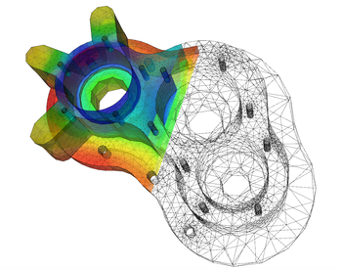

Types of differential equations
There are two main types: Ordinary and Partial
Ordinary differential equations (ODEs) are like the one listed earlier: $\frac{dy}{dx}=2e^{3x}−2x−2$
Partial differential equations (PDEs) are much harder to solve and are multivariable (which is why they have partials)
PDEs usually have no explicit solution
PDEs are used to model sound, heat, thermodynamics, fluid dynamics, electrostatics, quantum mechanics, etc.

Slide 4

The Heat Equation
The heat equation is one application of partial differential equation.
Can be written as where alpha is the coefficient of thermal diffusivity.
Notice the parentheses look like the divergence that we learned about in Unit 4.
$$\frac{∂u}{∂t}=α\left(\frac{∂^{2}u}{∂x^{2}}+\frac{∂^{2}u}{∂y^{2}}+\frac{∂^{2}u}{∂z^{2}}\right)$$
This shows how the temperature on a plane changes over time, with temperature being represented by height and color.

Slide 5

The Laplacian
The Laplacian is an operator defined as the divergence of the gradient
$∇⋅\left(\frac{∂f}{∂x},\frac{∂f}{∂y},\frac{∂f}{∂z}\right)=∇⋅∇f=∇^{2}f=Δf$ ← All equivalent expressions
This brings us back to the heat equation $\frac{∂u}{∂t}=α\left(\frac{∂^{2}u}{∂x^{2}}+\frac{∂^{2}u}{∂y^{2}}+\frac{∂^{2}u}{∂z^{2}}\right)$
Notice that the right-hand side is the Laplacian with a coefficient

Slide 6
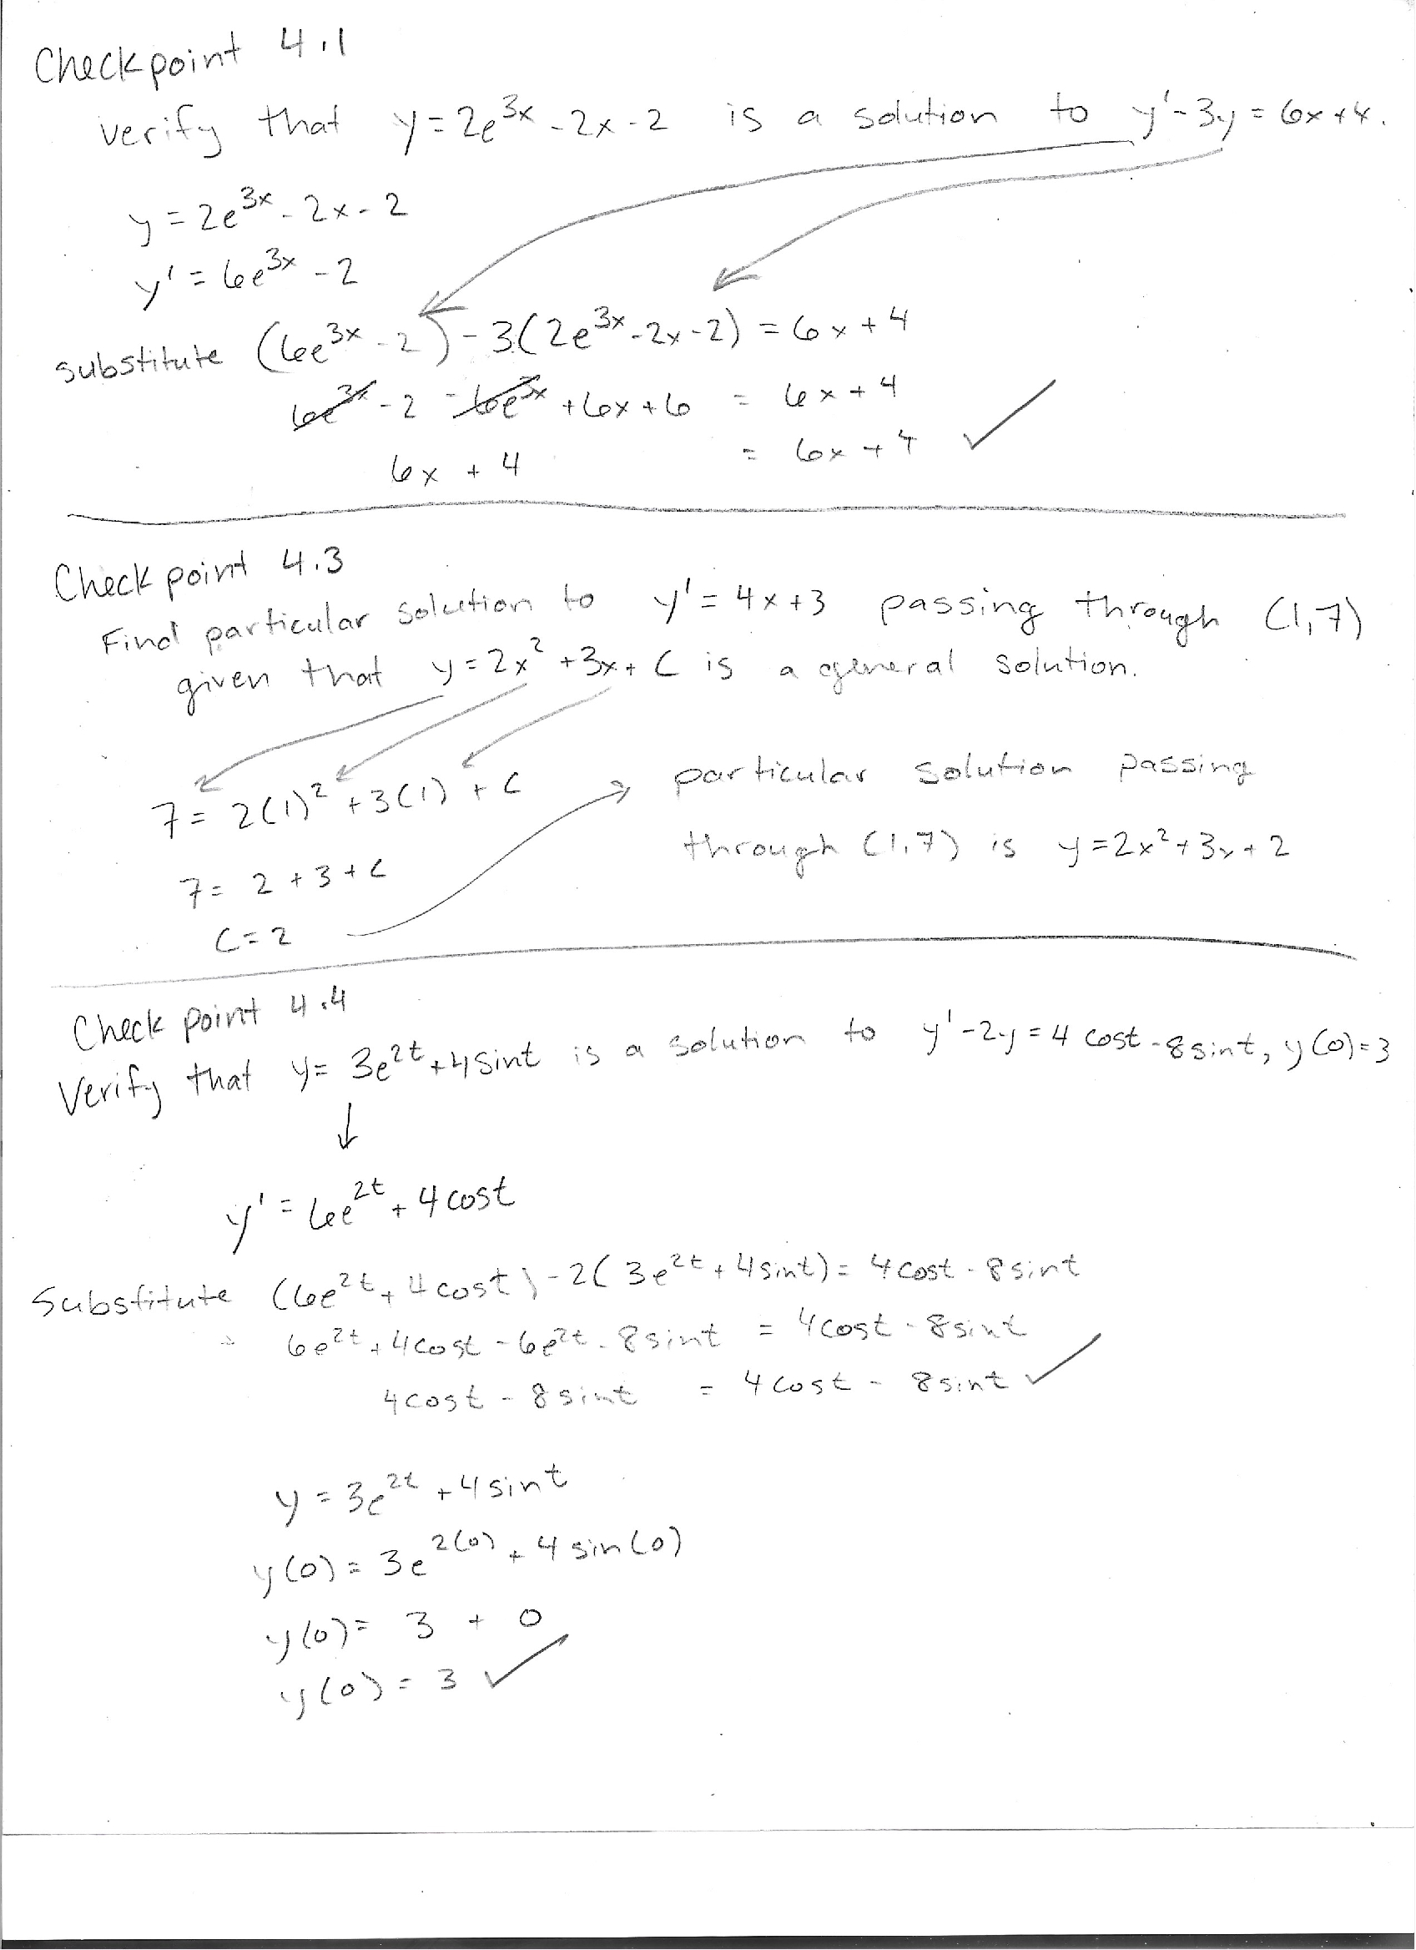
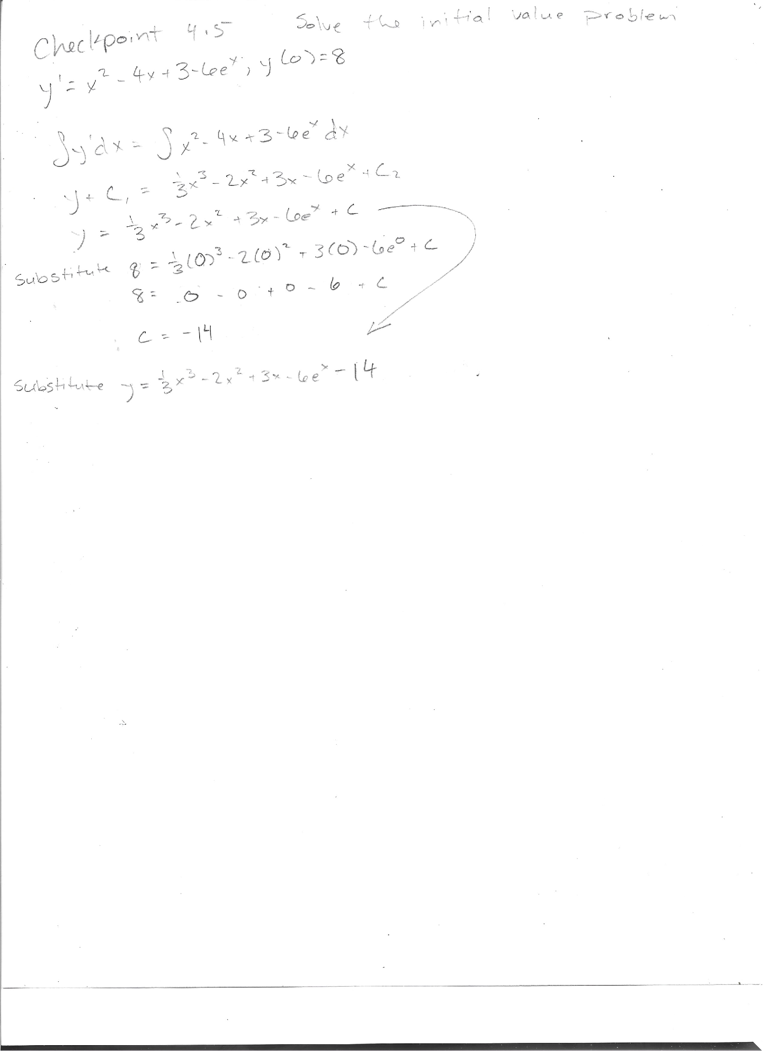
Example Work
I did some of the very simple checkpoint problems from the OpenStax Calculus Vol. II Textbook

